Slide 1
Make the first Serve!
Roundnet: The rising sport you should sponsor!
By Paul Böhmer and Peter Sesler
13.09.2022

Slide 2
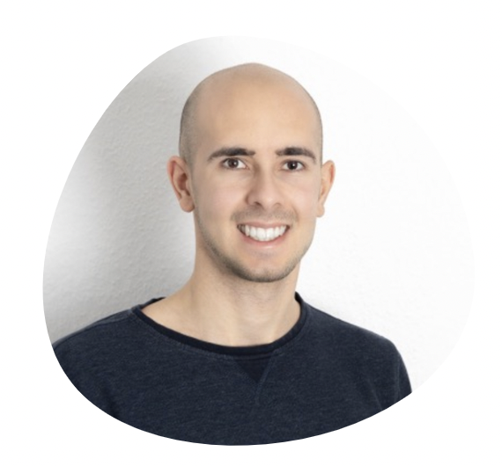


The team
mm
Peter Sesler
M.A. International Criminology
Hamburg
Paul Böhmer
B.A. Socioeconomics
Hamburg

Slide 3
Content
Introduction - What is Roundnet?
View on Germany
The proof: Roundnet is growing
Sponsoring assumptions
Dashboard: Give you a tool to decide which club you could sponsor

Slide 4
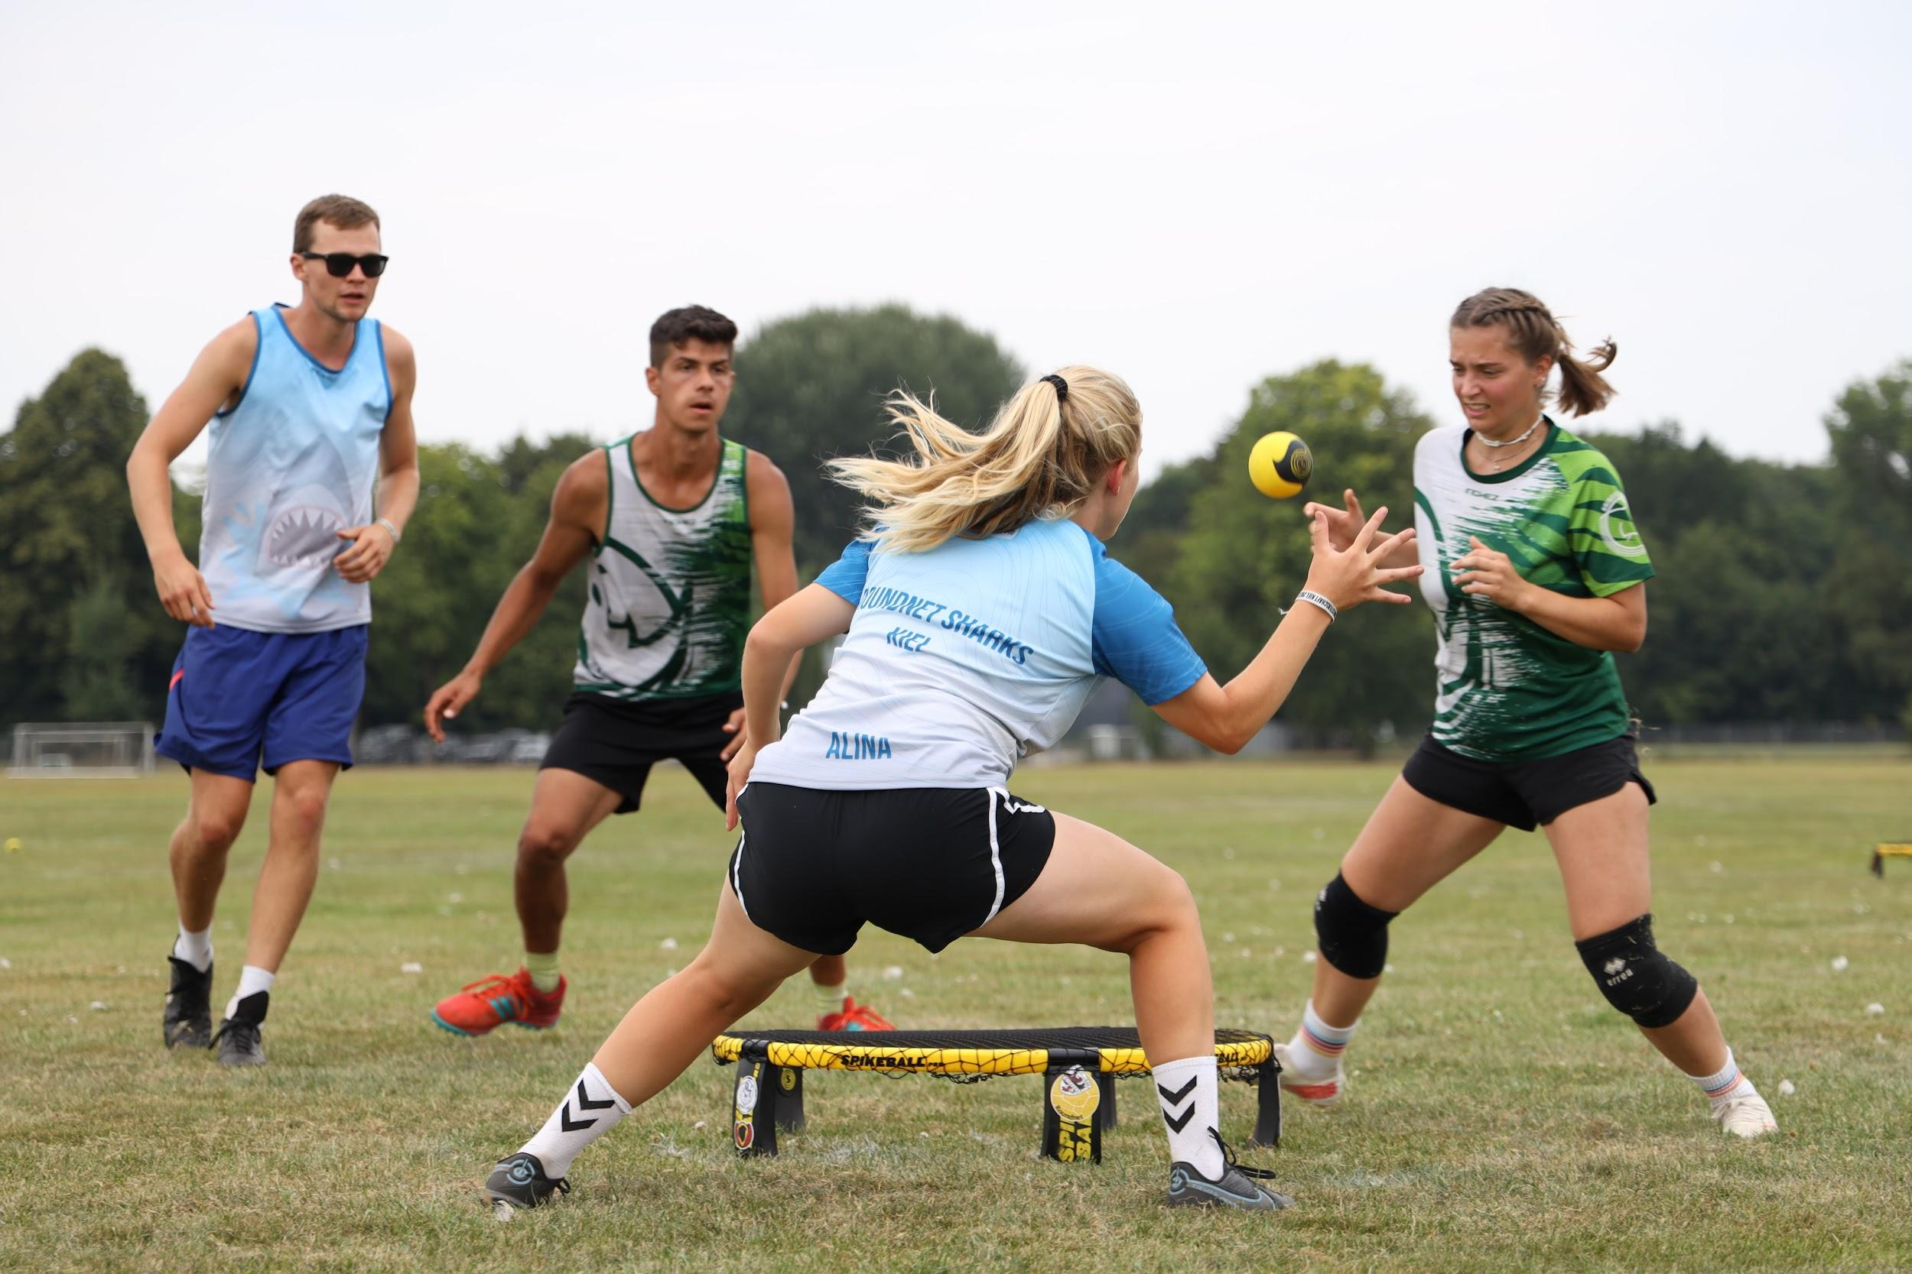
What is Roundnet?
Sports-Game
2 vs 2
360 Degrees Field
Different Surfaces
Just need a net
Fairplay
Notes:
to mention:
rules from Beach-Volleyball and Squash
three touches to get the ball to the net
the point is made, if the opponent can’t reach the ball or an error is made (rim, ball touches two times the net)

Slide 5
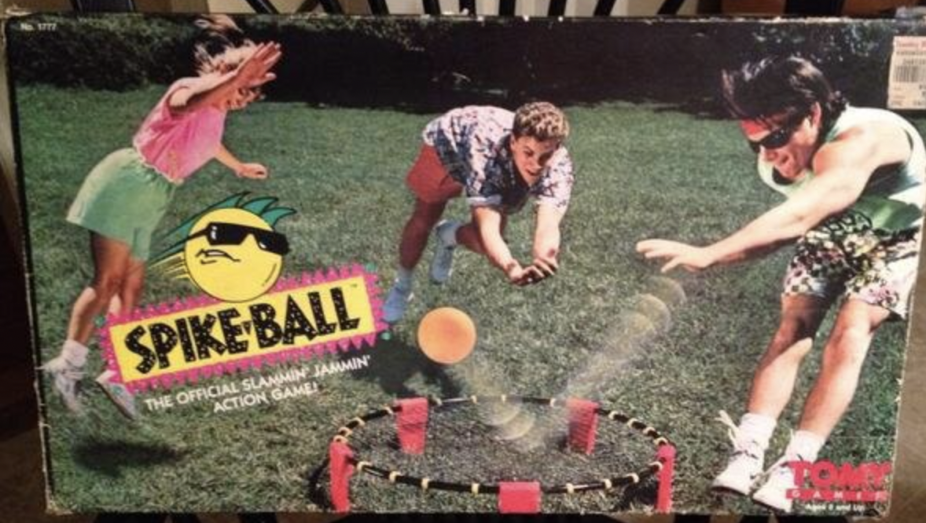
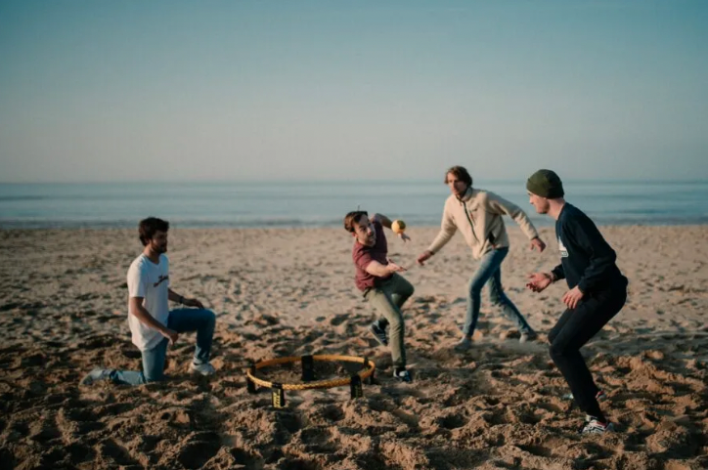
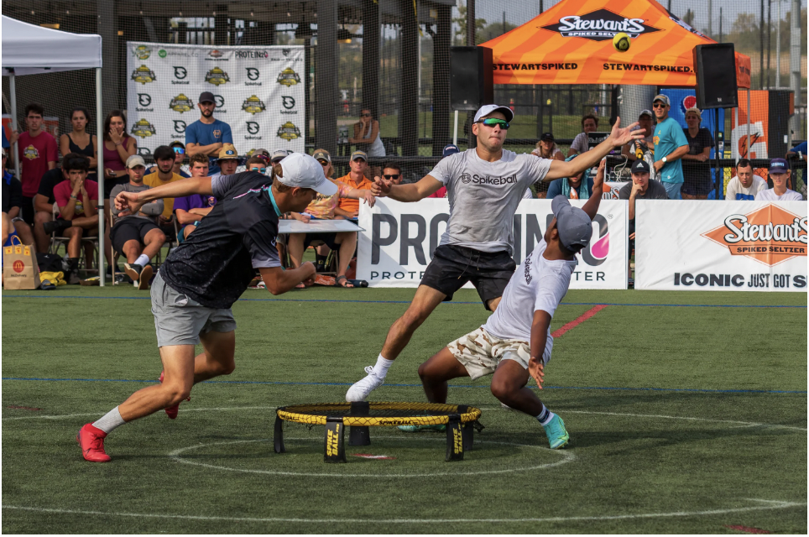
Short Sidelook on North America (the Beginning)
Foundation of the brand ‘Spikeball Inc’ by Chris Ruder
160 US-Colleges with Roundnet Teams
1989
2018
2021
Invented by Jeff Knorek
2008
Start of Broadcast the College Championships by ESPN
2020
Revenue of Spikeball Inc.:
39.3 Million US Dollar
Notes:
Separation between the brand Spikeball and the sport Roundnet in the year 20?? by world association

Slide 6
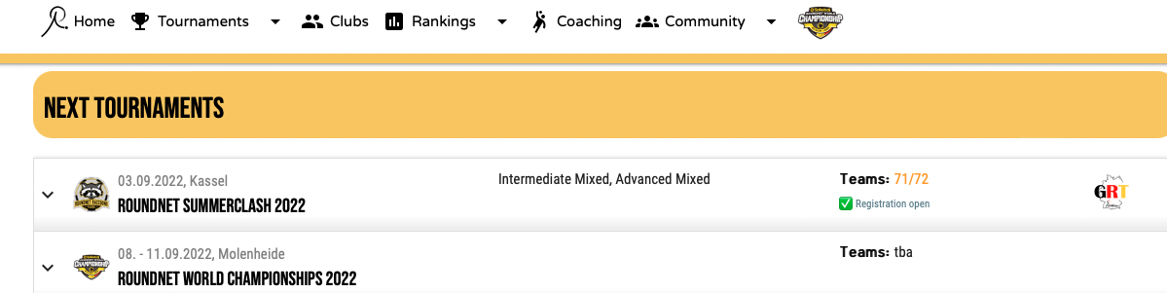
View on Germany (Data Set)
Data from the Roundnet-Playerzone
Task: Combine all given tables into one
Notes:
By clicking on the link:
first mention: what the playerzone is : a tool, where you have to enroll, if you want to play an official tournament!
show what we all get: information about the clubs, the tournaments, the players wo are playing the tournaments: also including rankings

Slide 7
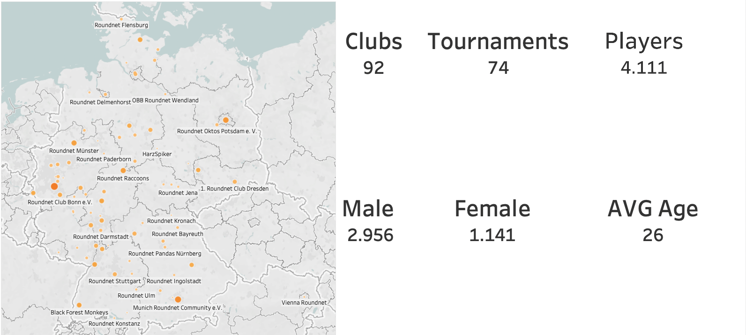





View on Germany

Slide 8














Aiming for Olympia
Main Goal: Become an Olympics Sports
National Team and League:
Professionalism
Education:
Winning interest of pupils
and students
Free Time Activities:
boost community:
We are here
Social Media:
increase visibility
unorganized Park Players

Slide 9
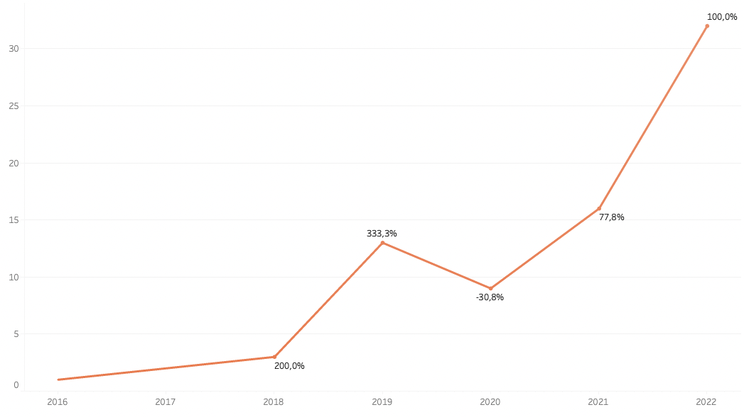
Tournaments per Year

Slide 10
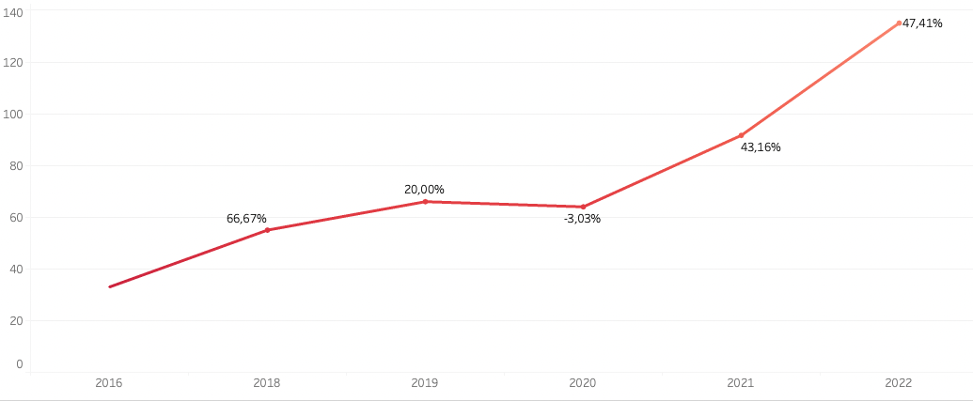
Players per Tournament per Year

Slide 11
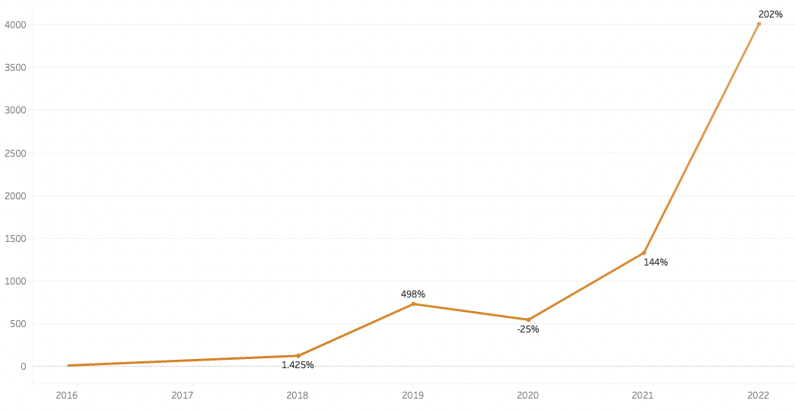
Total Players in Tournaments per Year

Slide 12
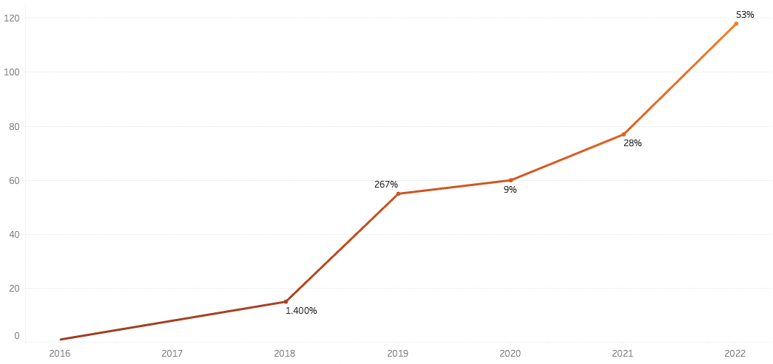
Destinations of Player per Year

Slide 13
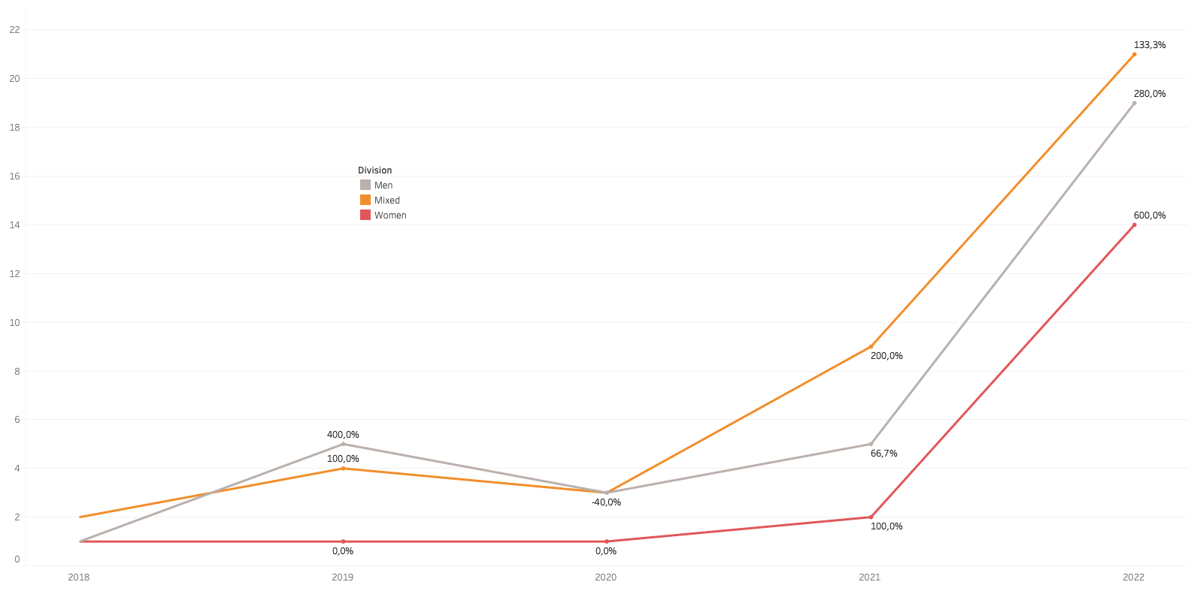
Divisions per Year

Slide 14
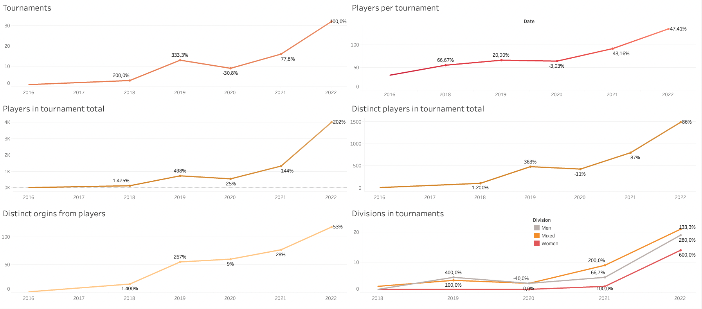
Overview: Everything is growing!

Slide 15
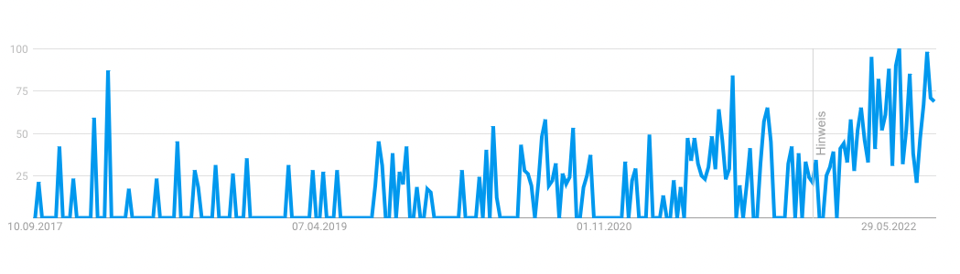
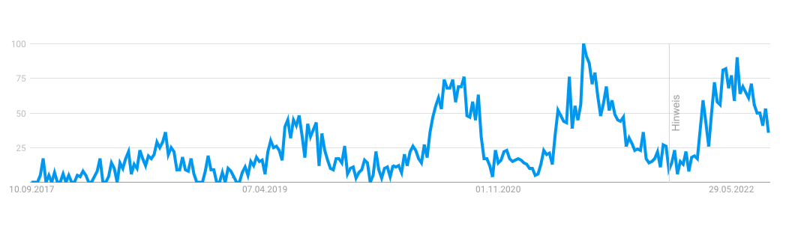
It’s growing! (Google Trend Germany)
Roundnet
Spikeball

Slide 16
Roundnet is the Rising Sport!
It doesn’t matter what you look for:
Clubs
Tournaments
Players
Every segment of the sport is growing!
(Keep in mind the Corona-Gap in 2020)
And we suggest a further growing the next years!

Slide 17
Assumptions for Sponsoring
Local:
Customers in the closer vicinity
Address regional target group
Nationwide:
Increase of brand awareness
Getting new customers
Global:
Produce content to attract your target group
Increase of market share within this target group
Create a positive brand-image

Slide 18
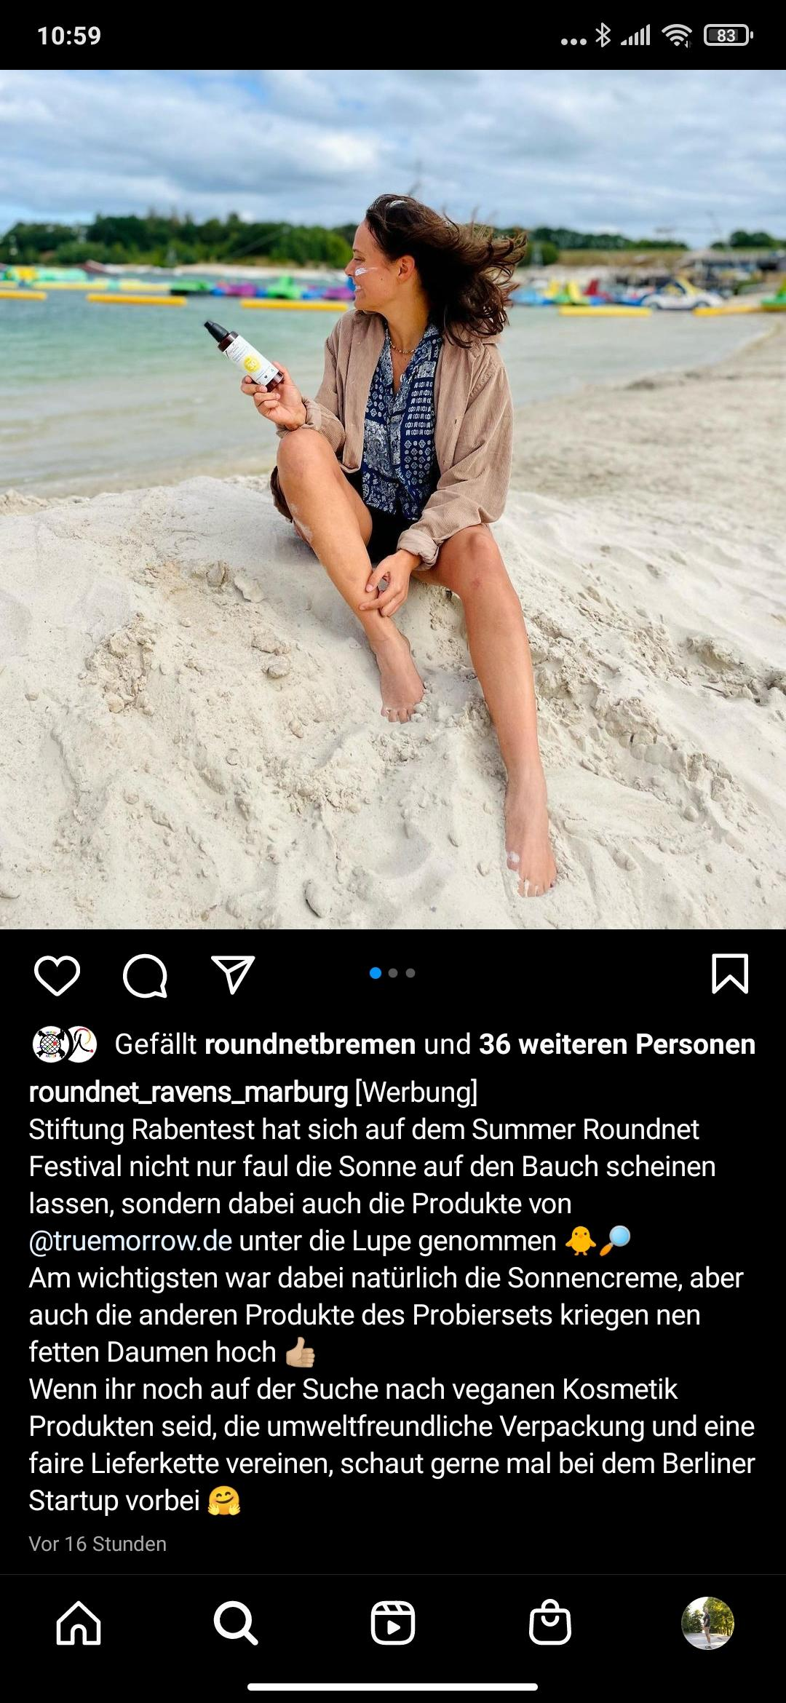
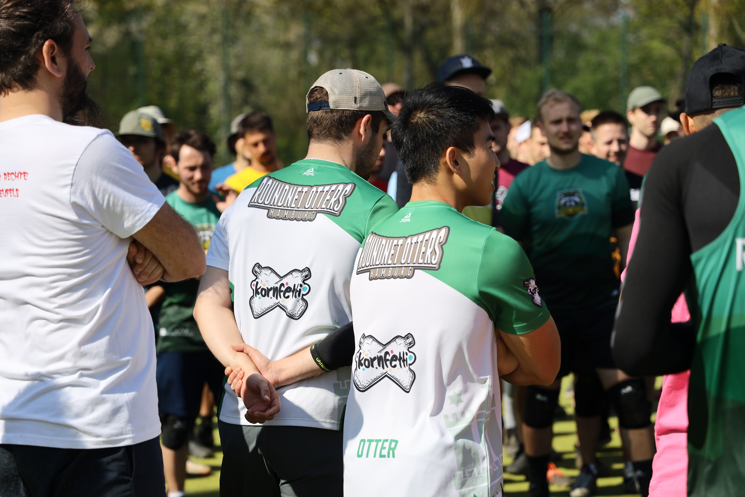
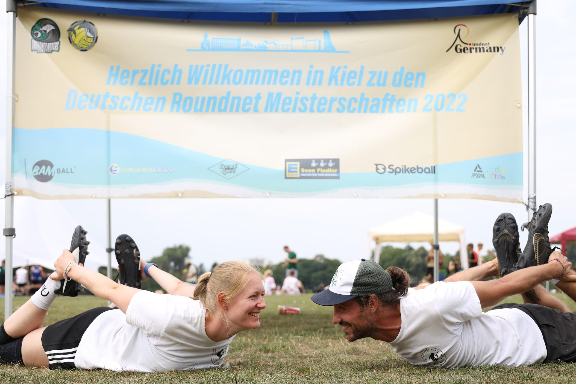
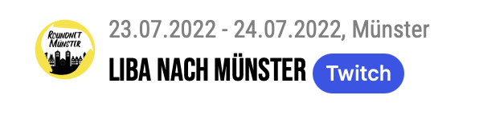


Already existing Sponsoring

Slide 19
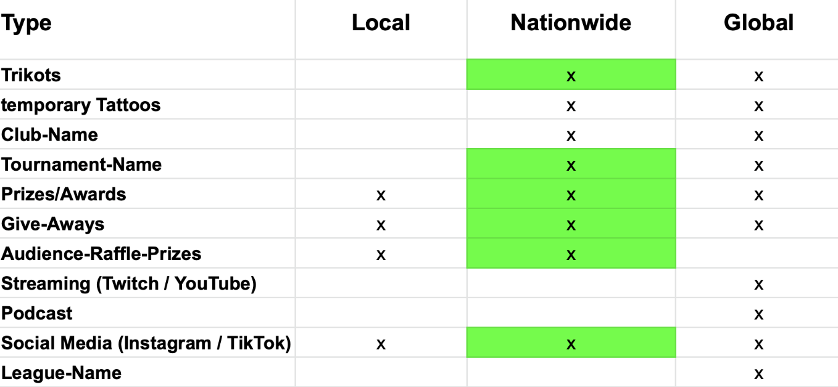
Sponsoring Possibilities

Slide 20
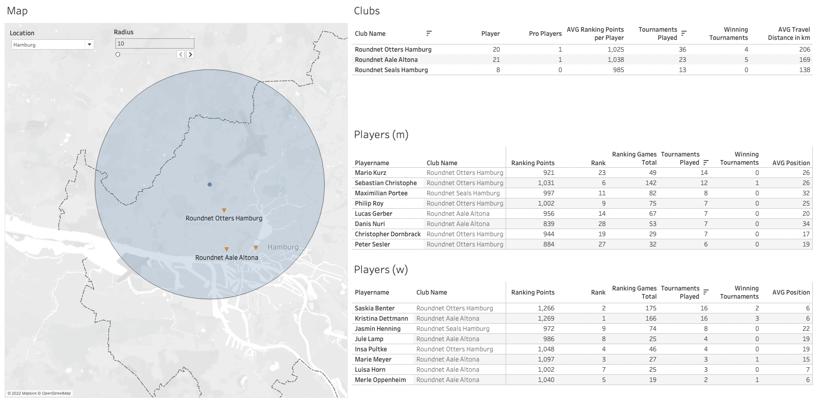
Dashboard
Second Step
First Step

Slide 21
Overview
Information about:
the Audience
Instagram-Followers
Twitch/YouTube-Streamings
Should be added to the data set
→ These would help us to give you better information which club you should sponsor!

Slide 22




Data Resource
You can find the dashboard in our GitHub
Also you can find there our dataset and the scripts for our analysis

Slide 23
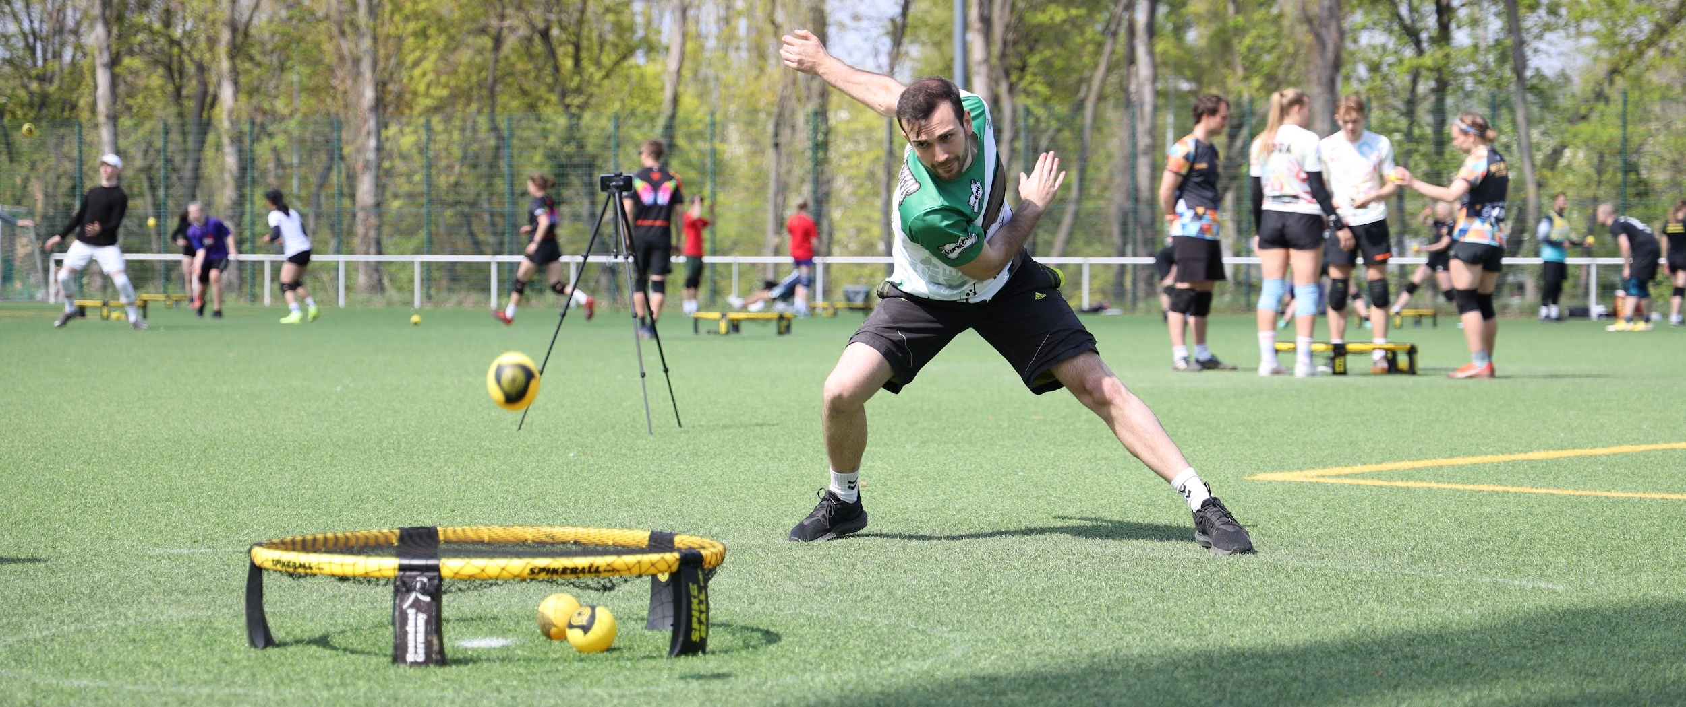
Now it’s Your Serve!
Thank you for being interested to be the next sponsor!

